Slide 1



Implementing Transformer with Python & PyTorch
Quang Duong

Slide 2
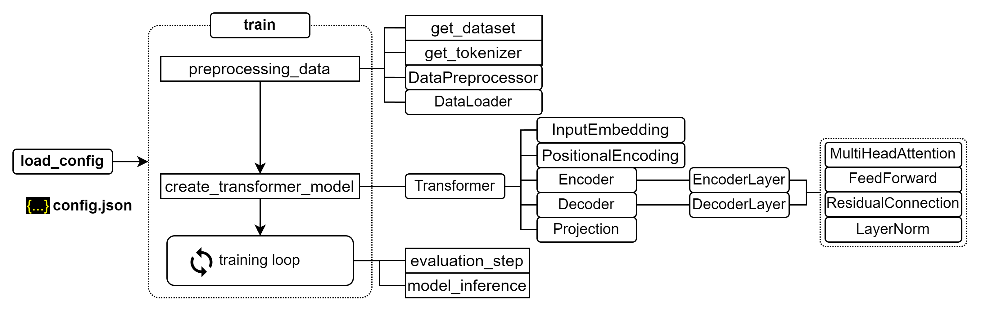
Training process for transformer

Slide 3
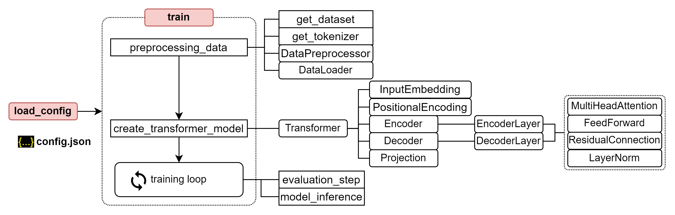
Training process for transformer

Slide 4
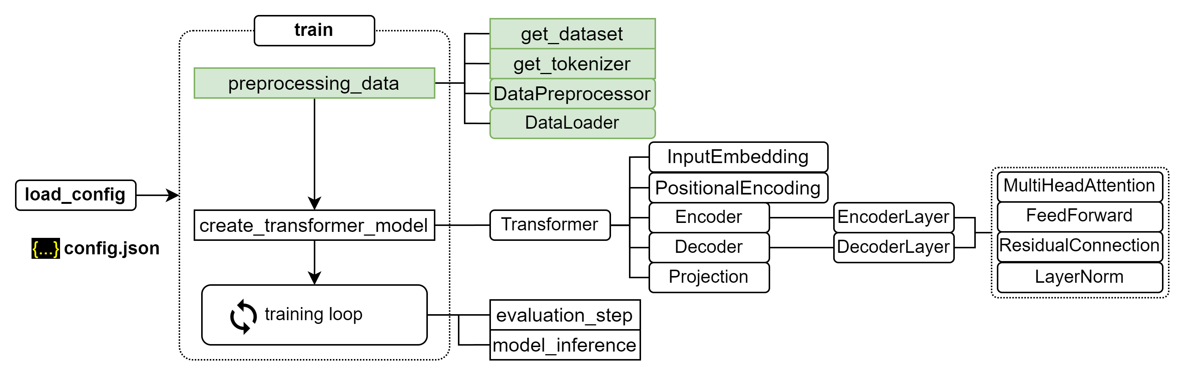
Training process for transformer

Slide 5
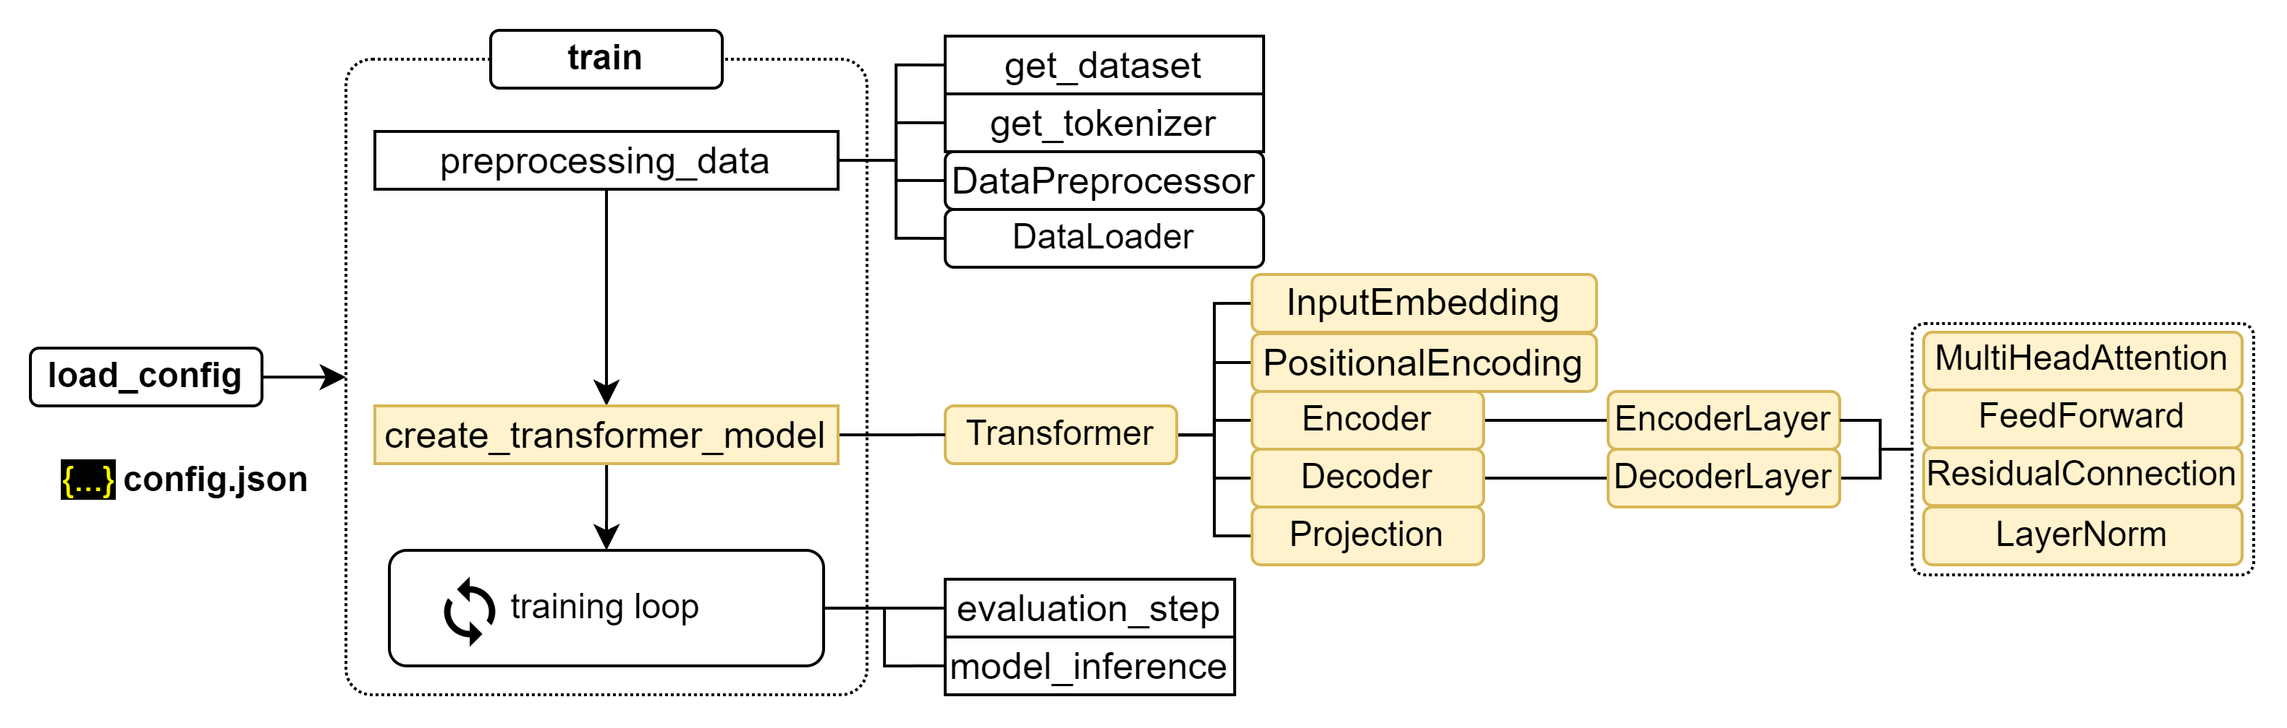
Training process for transformer

Slide 6
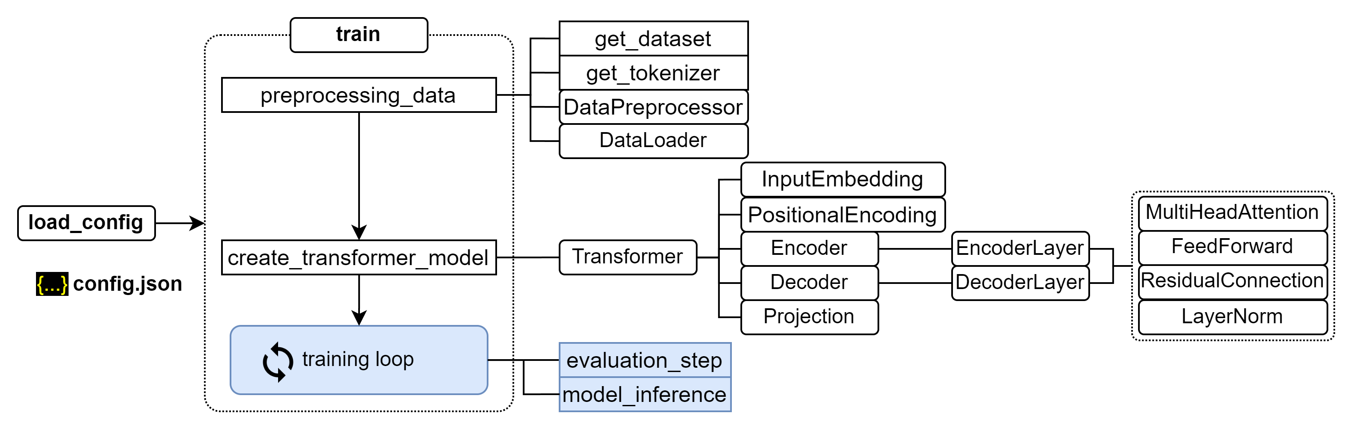
Training process for transformer

Slide 7
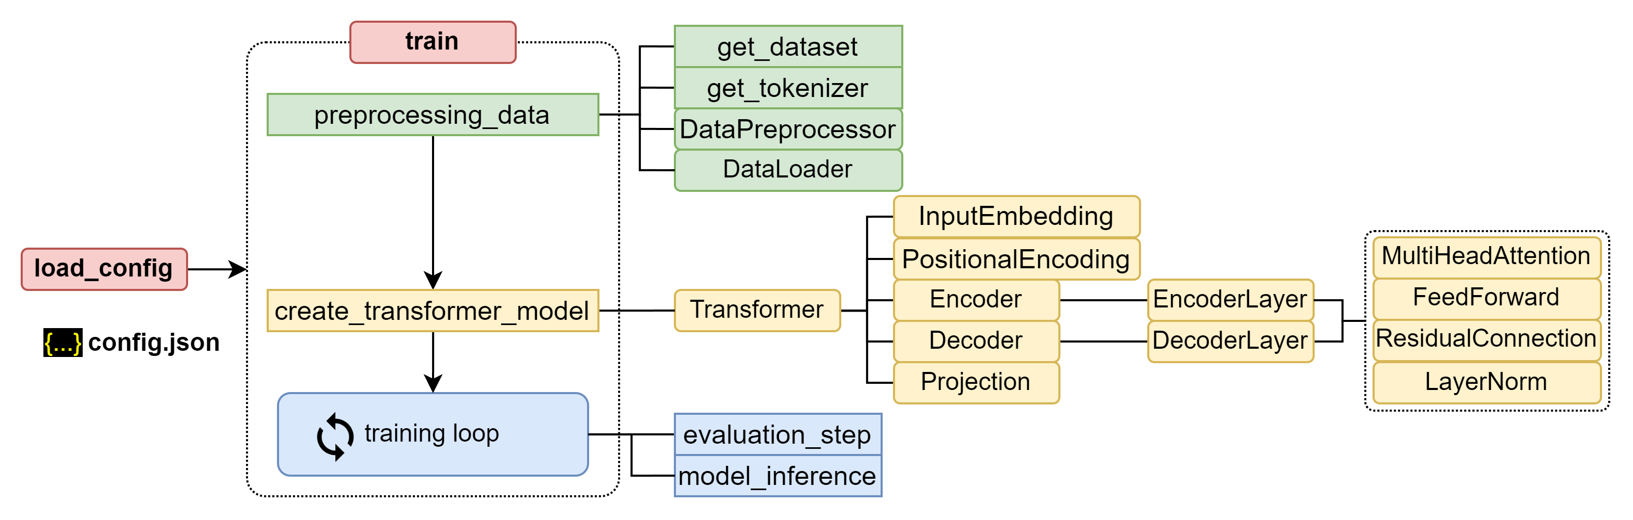
Training process for transformer

Slide 8
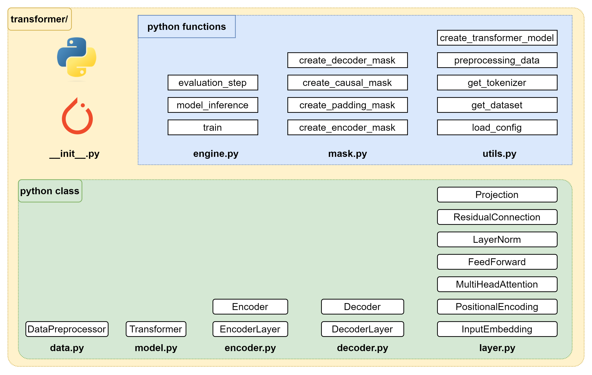
Building Transformer package

Slide 9
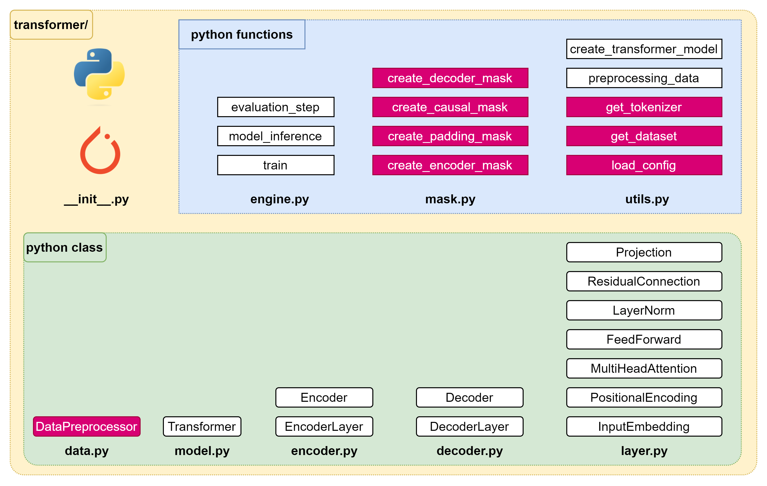
Implementation – Plan of attack (1/4)

Slide 10
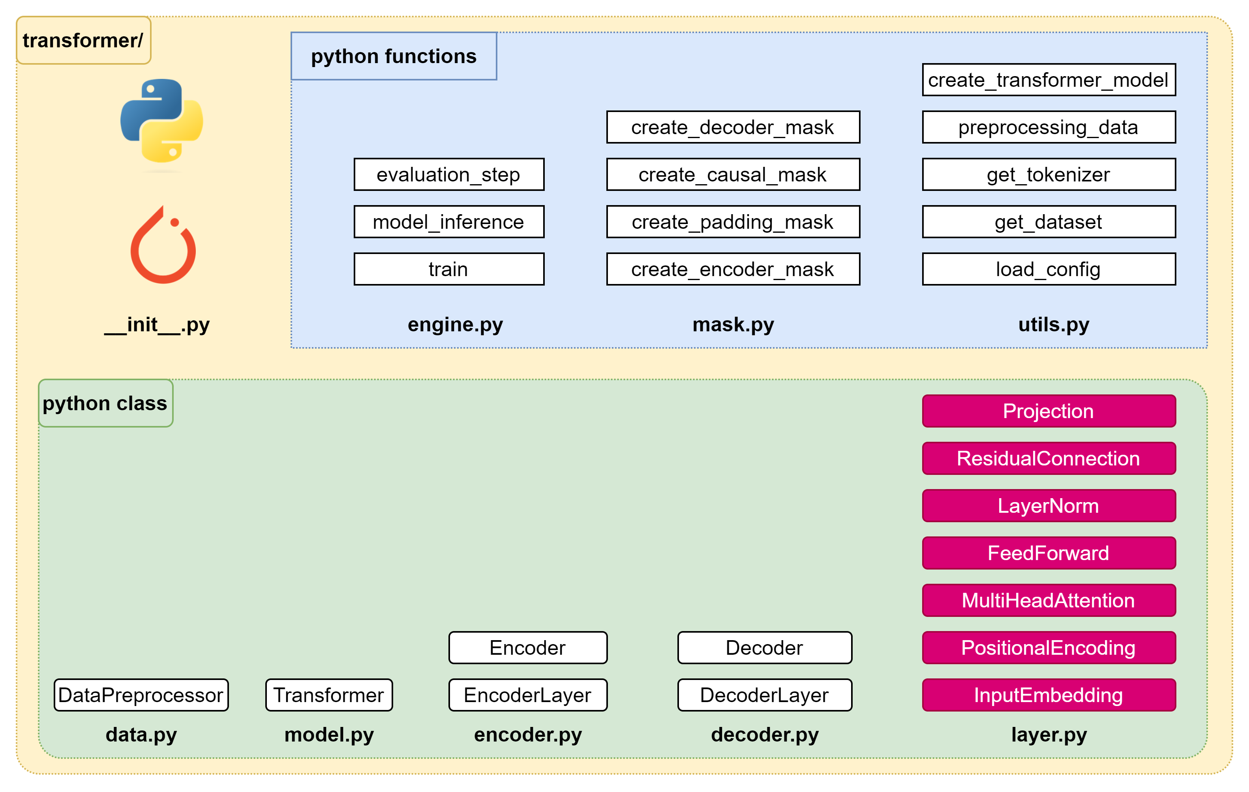
Implementation – Plan of attack (2/4)

Slide 11
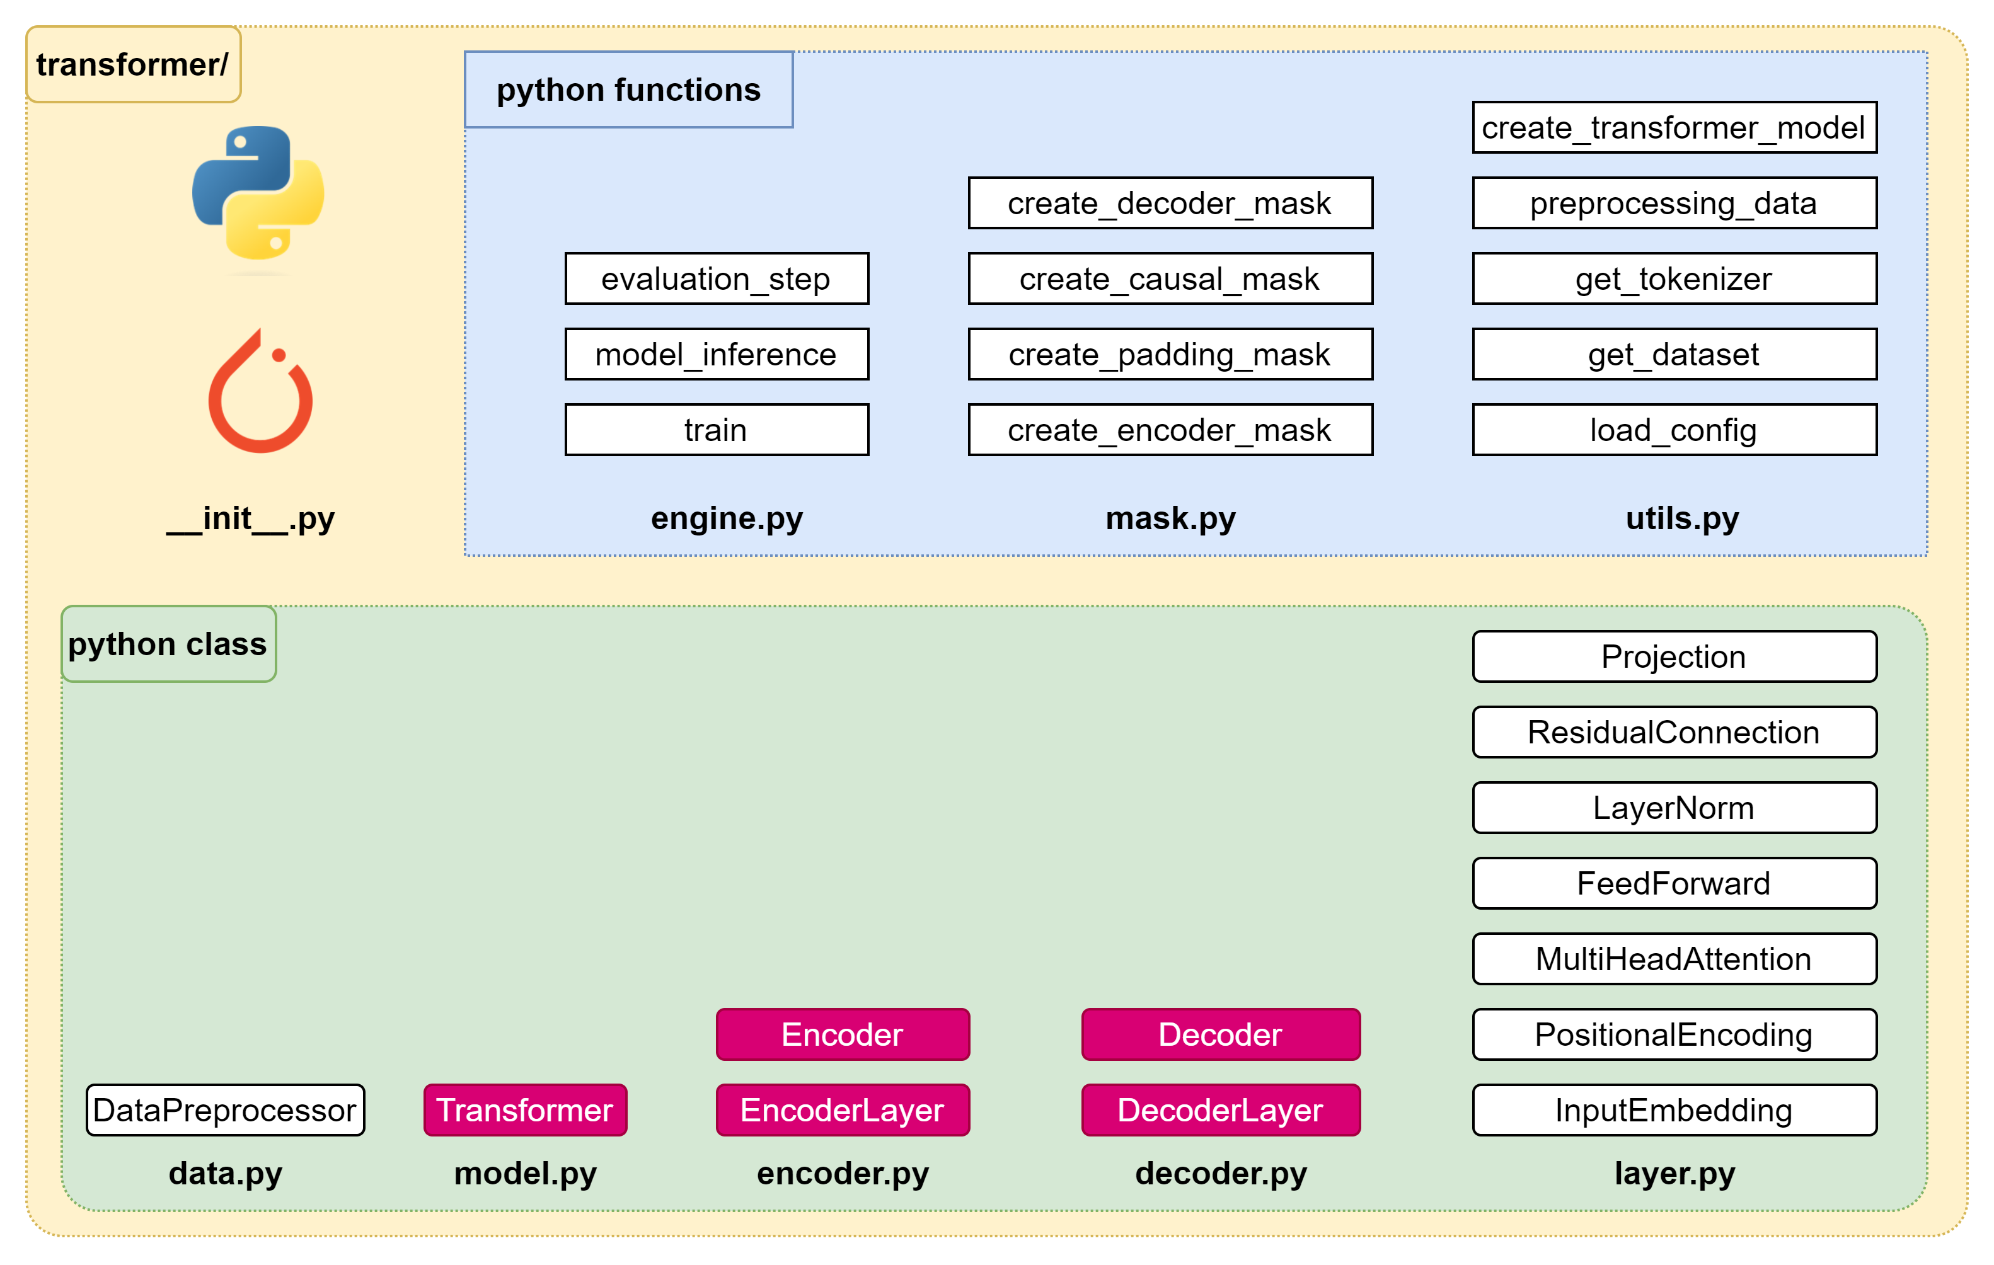
Implementation – Plan of attack (3/4)

Slide 12
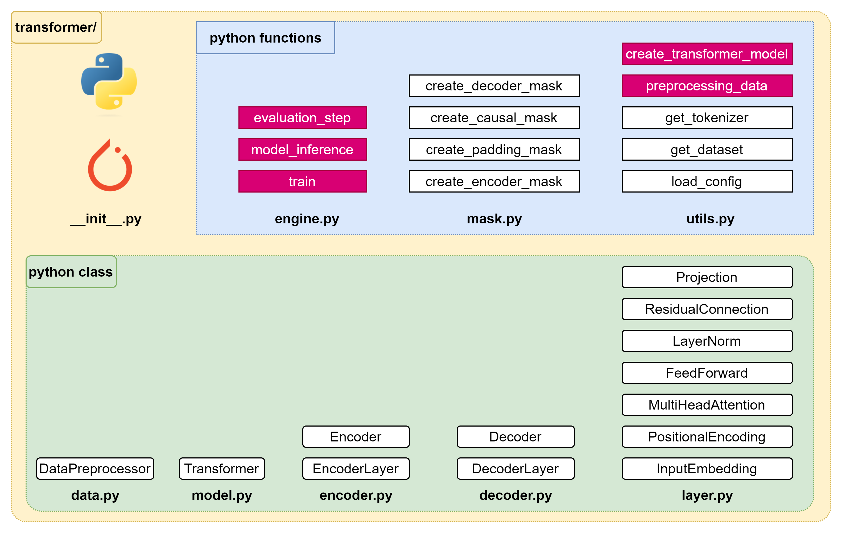
Implementation – Plan of attack (4/4)

Slide 14
Implementation – Plan of attack (1/4)

Slide 15

Data – Data Preprocessor

Slide 17
Implementation – Plan of attack (2/4)

Slide 19
Implementation – Plan of attack (3/4)

Slide 20

Encoder
encoder.py
import torch.nn as nn
from transformer.layer import FeedForward, MultiHeadAttention, ResidualConnection, LayerNorm
class EncoderLayer(nn.Module):
def __init__(self, d_model: int, self_attention: MultiHeadAttention, feed_forward: FeedForward, dropout: float,
) -> None:
super().__init__()
self.self_attention = self_attention
self.feed_forward = feed_forward
# Initialize the residual connections.
self.residual_connections = nn.ModuleList([ResidualConnection(d_model, dropout) for _ in range(2)])
def forward(self, x, mask_scr=None):
# x: [batch_size, seq_len, d_model]
# First, it applies the self-attention mechanism to the input inside a residual connection.
x = self.residual_connections[0](x, lambda x: self.self_attention(x, x, x, mask_scr))
# Then, it passes the result through the feed-forward network inside another residual connection.
x = self.residual_connections[1](x, self.feed_forward)
return x # [batch_size, seq_len, d_model].

Slide 21
Encoder
encoder.py
class Encoder(nn.Module):
def __init__(self, d_model: int, encoder_layer: EncoderLayer, num_layers: int) -> None:
super().__init__()
# Initialize the layers of the encoder.
self.layers = nn.ModuleList([encoder_layer for _ in range(num_layers)])
# Initialize the layer normalization.
self.norm = LayerNorm(d_model)
# The forward method is called when we pass input data into this module.
def forward(self, x, mask_scr=None):
# x: [batch_size, seq_len, d_model]
# It passes the input through each layer in turn.
for layer in self.layers:
x = layer(x, mask_scr)
# Finally, it applies layer normalization to the output of the last layer.
return self.norm(x) # [batch_size, seq_len, d_model].

Slide 22
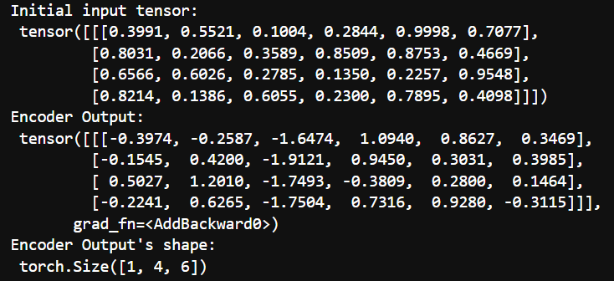
Encoder
nb_decoder.ipynb
import torch
from transformer.layer import MultiHeadAttention, FeedForward, LayerNorm
from transformer.encoder import EncoderLayer, Encoder
# Define configuration
d_model = 6 # feature dimension
h = 3 # number of heads
dropout = 0.1 # dropout ratio
d_ff = 2048 # the dimension of the feed forward network
batch = 1 # batch size
seq_len = 4 # sequence length num_layers = 3 # number of encoder layer
# Create an instance of the MultiHeadAttention & FeedForward classes
self_attention_engine = MultiHeadAttention(d_model, h, dropout)
feed_forward = FeedForward(d_model, d_ff, dropout)
# Create an instance of the EncoderLayer class
encoder_layer = EncoderLayer(d_model, self_attention_engine, feed_forward, dropout)
# Create an instance of the Encoder class
encoder = Encoder(d_model, encoder_layer, num_layers)
# Create a random tensor to represent a batch of sequences
torch.manual_seed(68) # for reproducible result of random process
x = torch.rand(batch, seq_len, d_model)
# Pass the tensor through the encoder
output = encoder(x)
print("Initial input tensor: \n", x)
print("Encoder Output: \n", output)
print("Encoder Output's shape: \n", output.shape)

Slide 24
Decoder
decoder.py
import torch.nn as nn
from transformer.layer import FeedForward, MultiHeadAttention, ResidualConnection, LayerNorm
class DecoderLayer(nn.Module):
def __init__(self, d_model: int, self_attention: MultiHeadAttention,
encoder_decoder_attention: MultiHeadAttention,
feed_forward: FeedForward, dropout: float) -> None:
super().__init__()
self.self_attention_engine = self_attention
self.encoder_decoder_attention = encoder_decoder_attention
self.feed_forward = feed_forward
# Initialize the residual connections.
self.residual_connections = nn.ModuleList([ResidualConnection(d_model, dropout) for _ in range(3)])
def forward(self, x, encoder_output, mask_src=None, mask_tgt=None):
# x: [batch_size, seq_de, d_model], encoder_output: [batch_size, seq_len, d_model]
x = self.residual_connections[0](x, lambda x: self.self_attention_engine(x, x, x, mask_tgt))
x = self.residual_connections[1](x, lambda x: self.encoder_decoder_attention(x, encoder_output, encoder_output, mask_src))
x = self.residual_connections[2](x, self.feed_forward)
return x

Slide 25
Decoder
decoder.py
class Decoder(nn.Module):
def __init__(self, d_model: int, decoder_layer: DecoderLayer, num_layers: int) -> None:
super().__init__()
# Initialize the layers of the decoder.
self.layers = nn.ModuleList([decoder_layer for _ in range(num_layers)])
# Initialize the layer normalization.
self.norm = LayerNorm(d_model)
def forward(self, x, encoder_output, mask_src=None, mask_tgt=None):
# x: [batch_size, seq_len, d_model]
# It passes the input and the encoder output through each layer in turn.
for layer in self.layers:
x = layer(x, encoder_output, mask_src, mask_tgt)
# Finally, it applies layer normalization to the output of the last layer.
return self.norm(x) # [batch_size, seq_len, d_model].

Slide 26
Decoder
nb_decoder.ipynb
import torch
from transformer.layer import MultiHeadAttention, FeedForward, LayerNorm
from transformer.decoder import DecoderLayer, Decoder
# Define configuration
d_model = 6 # feature dimension
h = 6 # number of heads
dropout = 0.1 # dropout ratio
d_ff = 2048 # the dimension of the feed forward network
batch_size = 1 # batch size
seq_len = 4 # sequence length
num_layers = 3 # number of encoder layer
# Create an instance of the MultiHeadAttention and FeedForward classes
self_attention = MultiHeadAttention(d_model, h, dropout)
encoder_decoder_attention = MultiHeadAttention(d_model, h, dropout)
feed_forward = FeedForward(d_model, d_ff, dropout)
# Create an instance of the DecoderLayer class
decoder_layer = DecoderLayer(d_model, self_attention, encoder_decoder_attention, feed_forward, dropout)
# Create an instance of the Decoder class
decoder = Decoder(d_model, decoder_layer, num_layers)
# Create a random tensor to represent a batch of sequences
torch.manual_seed(68) # for reproducible result of random process
x = torch.rand(batch_size, seq_len, d_model)
torch.manual_seed(101) # for reproducible result of random process
encoder_output = torch.rand(batch_size, seq_len, d_model)
# Pass the tensor through the decoder
output = decoder(x, encoder_output)

Slide 28
Transformer
model.py
import torch.nn as nn
from transformer.layer import InputEmbedding, PositionalEncoding, Projection
from transformer.encoder import Encoder
from transformer.decoder import Decoder
class Transformer(nn.Module):
def __init__(self, encoder: Encoder,
decoder: Decoder,
embed_src: InputEmbedding,
embed_tgt: InputEmbedding,
pos_src: PositionalEncoding,
pos_tgt: PositionalEncoding,
projection: Projection,
) -> None:
super().__init__()
self.encoder = encoder
self.decoder = decoder
self.embed_src = embed_src
self.embed_tgt = embed_tgt
self.pos_src = pos_src
self.pos_tgt = pos_tgt
self.projection = projection
def encode(self, src, mask_src=None):
src = self.embed_src(src)
src = self.pos_src(src)
return self.encoder(src, mask_src)
def decode(self, tgt, encoder_output, mask_src=None, mask_tgt=None):
tgt = self.embed_tgt(tgt)
tgt = self.pos_tgt(tgt)
return self.decoder(tgt, encoder_output, mask_src, mask_tgt)
def project(self, x):
return self.projection(x)

Slide 30
Implementation – Plan of attack (4/4)

Slide 31
Utils – Preprocessing data
utils.py
def preprocessing_data(config):
# Get the raw dataset
raw_dataset = get_dataset(config)
# Initialize tokenizers for the source & target languages
tokenizer_src = get_tokenizer(config, raw_dataset, config["language_source"])
tokenizer_tgt = get_tokenizer(config, raw_dataset, config["language_target"])
# Calculate the sizes of the training, validation, and test sets
train_ds_size = int(len(raw_dataset) * 0.7)
val_ds_size = int(len(raw_dataset) * 0.2)
test_ds_size = len(raw_dataset) - train_ds_size - val_ds_size
# Split the raw dataset into training, validation, and test sets
train_raw_dataset, val_raw_dataset, test_raw_dataset = random_split(raw_dataset, [train_ds_size, val_ds_size, test_ds_size])
# Preprocess the training, validation, and test sets
train_ds = DataPreprocessor(
train_raw_dataset,
tokenizer_src, tokenizer_tgt,
config["language_source"],
config["language_target"],
config["seq_len"],)
val_ds = DataPreprocessor(
val_raw_dataset,
tokenizer_src, tokenizer_tgt,
config["language_source"],
config["language_target"],
config["seq_len"],)
test_ds = DataPreprocessor(
test_raw_dataset,
tokenizer_src, tokenizer_tgt,
config["language_source"],
config["language_target"],
config["seq_len"],)

Slide 32
Utils – Preprocessing data
utils.py
# Create DataLoaders for the training, validation, and test sets
train_dataloader = DataLoader(train_ds, batch_size=config["batch_size"], shuffle=True)
val_dataloader = DataLoader(val_ds, batch_size=1, shuffle=True)
test_dataloader = DataLoader(test_ds, batch_size=1, shuffle=True)
return (
train_dataloader,
val_dataloader,
test_dataloader,
tokenizer_src,
tokenizer_tgt,
)

Slide 33
Utils – Create transformer model
utils.py
def create_tranformer_model(config, vocab_size_src, vocab_size_tgt) -> Transformer:
# Extract parameters from the configuration
d_model = config["d_model"]
num_layers = config["num_layers"]
h = config["h"]
d_ff = config["d_ff"]
dropout = config["dropout"]
seq_len = config["seq_len"]
# Initialize the source and target embedding layers
embed_src = InputEmbedding(vocab_size_src, d_model)
embed_tgt = InputEmbedding(vocab_size_tgt, d_model)
# Initialize the source & target positional encoding layers
pos_src = PositionalEncoding(d_model, seq_len, dropout)
pos_tgt = PositionalEncoding(d_model, seq_len, dropout)
# Initialize the encoder with self-attention and feed-forward layers
self_attention_encoder = MultiHeadAttention(d_model, h, dropout)
feed_forward_encoder = FeedForward(d_model, d_ff, dropout)
encoder_layer = EncoderLayer(
d_model, self_attention_encoder, feed_forward_encoder, dropout)
encoder = Encoder(d_model, encoder_layer, num_layers)

Slide 34
Utils – Preprocessing data
utils.py
# Initialize the decoder with self-attention, encoder-decoder attention, and feed-forward layers
self_attention_decoder = MultiHeadAttention(d_model, h, dropout)
encoder_decoder_attention = MultiHeadAttention(d_model, h, dropout)
feed_forward_decoder = FeedForward(d_model, d_ff, dropout)
decoder_layer = DecoderLayer(
d_model,
self_attention_decoder,
encoder_decoder_attention,
feed_forward_decoder,
dropout,
)
decoder = Decoder(d_model, decoder_layer, num_layers)
# Initialize the projection layer
projection = Projection(d_model, vocab_size_tgt)
# Initialize the Transformer model
transformer = Transformer(
encoder,
decoder,
embed_src,
embed_tgt,
pos_src,
pos_tgt,
projection,
)
# Initialize the model parameters with Xavier uniform distribution
for param in transformer.parameters():
if param.dim() > 1:
nn.init.xavier_uniform_(param)
return transformer

Slide 36
